Slide 1
Context Free Grammars (CFG)
COP 4020
Pete Dobbins

Slide 2
Language Translation
Step 1: Lexical Analysis
Convert sequence of characters into a sequence of potential tokens.
Lexical structure typically specified with regular expressions.
Step 2: Parsing
Recognize legal phrases [token order] using the rules of a grammar (CFG).
Construct an Abstract Syntax Tree (AST).
Does not use regular expressions!

Slide 3
Why Not Parse with Regular Expressions?
The language of expressions cannot be specified
with regular expressions
Regular expressions are not recursive
Thus, cannot specify nested constructs

Slide 4

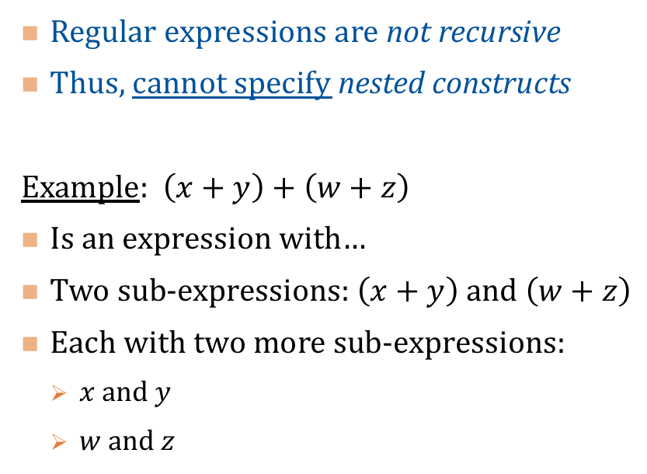



Why Not Parse with Regular Expressions?
Regular expressions are not recursive
Thus, cannot specify nested constructs
Example: $\left(x+y\right)+\left(w+z\right)$
Is an expression with…
Two sub-expressions: $\left(x+y\right)$ and $\left(w+z\right)$
Each with two more sub-expressions:
$x$ and $y$
$w$ and $z$
AST
Token Type: OPERATOR
+
+
+
$$x$$
$$y$$
$$w$$
$$z$$

Slide 5
Why Not Parse with Regular Expressions?
Regular expressions are not recursive
Thus, cannot specify nested constructs
Example: $\left(x+y\right)+\left(w+z\right)$
Is an expression with…
Two sub-expressions: $\left(x+y\right)$ and $\left(w+z\right)$
Each with two more sub-expressions:
$x$ and $y$
$w$ and $z$
AST
Token Type: OPERATOR
+
Token Type: IDENTIFIER
+
+
$$x$$
$$y$$
$$w$$
$$z$$

Slide 6

BNF | EBNF $→$ CGF
Instead we use a Grammar
BNF: Backus-Naur Form
EBNF: Extended BNF notation
BNF allows us to specify Context-Free Grammars (CFG).

Slide 7
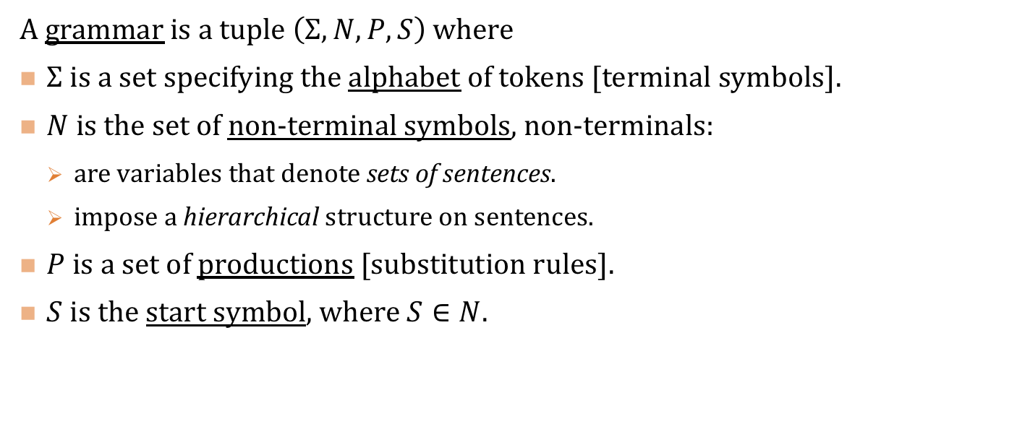
Context Free Grammar
A grammar is a tuple $\left(Σ,N,P,S\right)$ where
$Σ$ is a set specifying the alphabet of tokens [terminal symbols].
$N$ is the set of non-terminal symbols, non-terminals:
are variables that denote sets of sentences.
impose a hierarchical structure on sentences.
$P$ is a set of productions [substitution rules].
$S$ is the start symbol, where $S∈N$.

Slide 8
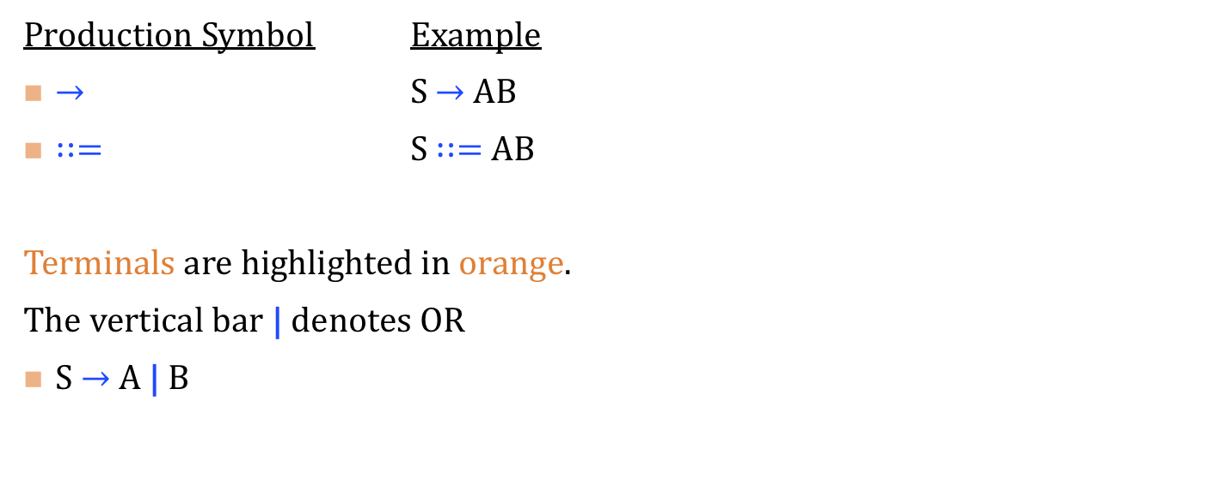
Grammar: Notation
Production Symbol Example
$→$ S $→$ AB
$∷=$ S $∷=$ AB
Terminals are highlighted in orange.
The vertical bar | denotes OR
S $→$ A | B

Slide 9
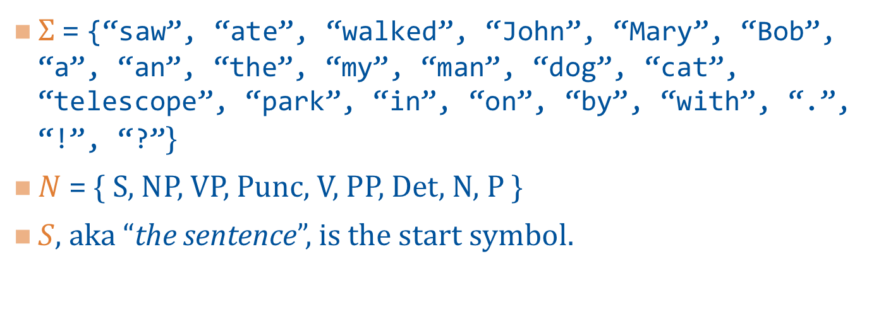

Sample Grammar #1: $Σ,N,S$
$Σ$ = {“saw”, “ate”, “walked”, “John”, “Mary”, “Bob”, “a”, “an”, “the”, “my”, “man”, “dog”, “cat”, “telescope”, “park”, “in”, “on”, “by”, “with”, “.”, “!”, “?”}
$N$ = { S, NP, VP, Punc, V, PP, Det, N, P }
$S$, aka “the sentence”, is the start symbol.

Slide 10
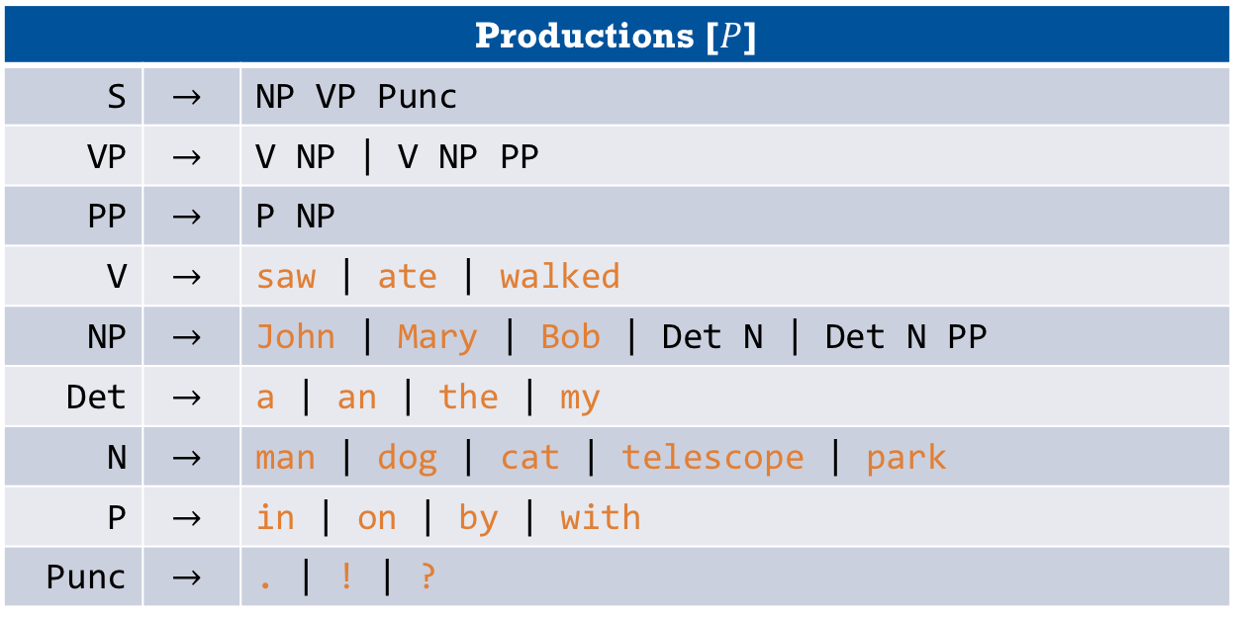
Sample Grammar #1
Productions [$P$]
S | $$→$$ | NP VP Punc
VP | $$→$$ | V NP | V NP PP
PP | $$→$$ | P NP
V | $$→$$ | saw | ate | walked
NP | $$→$$ | John | Mary | Bob | Det N | Det N PP
Det | $$→$$ | a | an | the | my
N | $$→$$ | man | dog | cat | telescope | park
P | $$→$$ | in | on | by | with
Punc | $$→$$ | . | ! | ?

Slide 11
Example: “Mary saw Bob?”
First we show how the rules of Grammar #1 match this sentence. Then, we will draw up a tree representation of how the grammar parses the sentence.
(S (NP Mary) (VP (V saw) (NP Bob) ) (Punc ?) )

Slide 12
(S (NP Mary) (VP (V saw) (NP Bob) ) (Punc ?) )
S
NP
VP
Punc
Mary
V
NP
?
saw
Bob

Slide 13
Consider Another Sentence
“the humans saw crazy Pete chase the horrified zombie!”
How does this sentence parse using Grammar #1?
What will need be included in Grammar #2?
First, we will create Grammar #2,
Then, we will show how Grammar #2 produces the sentence,
and Finally, we will draw the corresponding parse tree.

Slide 14
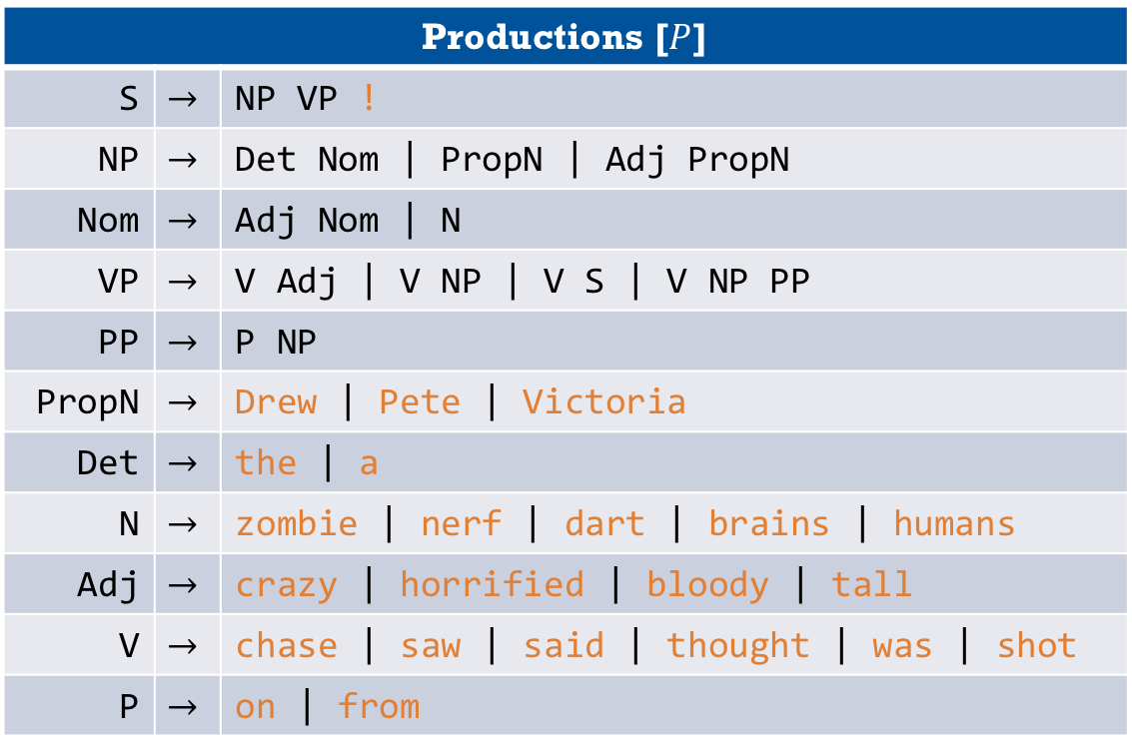
Grammar #2
Productions [$P$]
S | $$→$$ | NP VP !
NP | $$→$$ | Det Nom | PropN | Adj PropN
Nom | $$→$$ | Adj Nom | N
VP | $$→$$ | V Adj | V NP | V S | V NP PP
PP | $$→$$ | P NP
PropN | $$→$$ | Drew | Pete | Victoria
Det | $$→$$ | the | a
N | $$→$$ | zombie | nerf | dart | brains | humans
Adj | $$→$$ | crazy | horrified | bloody | tall
V | $$→$$ | chase | saw | said | thought | was | shot
P | $$→$$ | on | from

Slide 15
“the humans saw crazy Pete chase the horrified zombie!”
(S
(NP (Det the) (Nom (N humans) ) )
(VP
(V saw)
(S
(NP (Adj crazy) (PropN Pete) )
(VP
(V chase)
(NP (Det the) (Nom (Adj horrified) (Nom (N zombie))))))) !)

Slide 16
Sample Code
class CFGExample{public static void main(String args[]){int n;String result;n=5;if(n%2==0){result="even";}else{result="odd";}System.out.println(n+" is "+result);}}

Slide 17
Benefits of (E)BNF Notation
Compact and precise specification that allows an infinite number of sentences to be specified with a finite definition.
Allows systematic | automatic generation of efficient parsers for certain types of grammars.
Provides a framework for specifying semantics [more on this later].
Allows formal reasoning about languages.

Slide 18
Parsing
Grammars give rules for generating sentences in a language.
Parsing is the process of recognizing the language (and determining its structure).
Parse trees are a way of representing the structure of a sentence.
start symbol at the root
non-terminals at interior nodes
terminals as leaves

Slide 19
Approaches to Parsing
Bottom-up: we will only briefly cover this.
Top-down [recursive descent]
We will focus on this and use it in our project.
Characteristic of grammars that allow top-down parsing:
LL grammars
FIRST, FOLLOW, and PREDICT sets
Transformations on grammars.

Slide 20
Top-down Parsing
Begin with the start symbol in the language.
At each step: replace a non-terminal symbol with one of its productions, trying to match prefixes in the sentence.
Remove matching prefixes.
If the resulting string is empty, then the sentence is in the grammar!

Slide 21
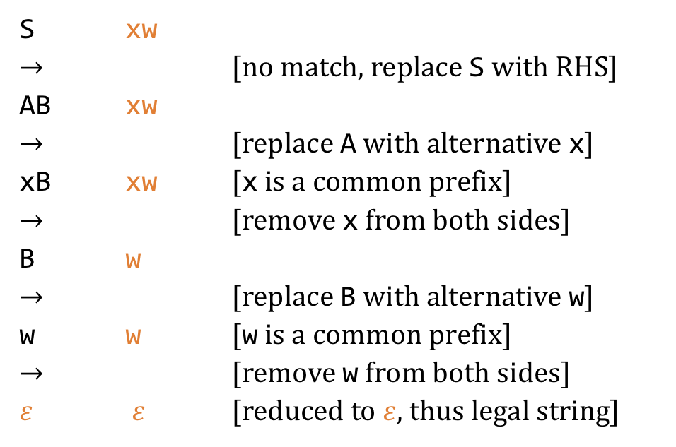
Example: Top-down Parsing [7]
S ::= AB
A ::= x | y
B ::= z | w
String to parse: xw
S xw
$→$ [no match, replace S with RHS]
AB xw
$→$ [replace A with alternative x]
xB xw [x is a common prefix]
$→$ [remove x from both sides]
B w
$→$ [replace B with alternative w]
w w [w is a common prefix]
$→$ [remove w from both sides]
$ε$ $ε$ [reduced to $ε$, thus legal string]

Slide 22
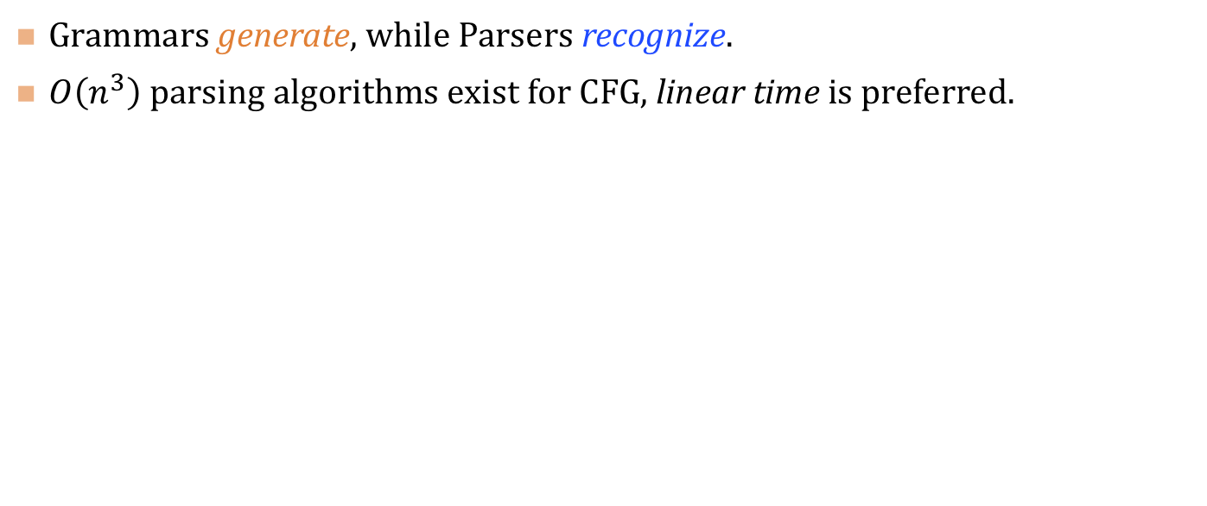
Grammars and Parsing
Grammars generate, while Parsers recognize.
$O\left(n^{3}\right)$ parsing algorithms exist for CFG, linear time is preferred.

